Slide 1


Slide 2
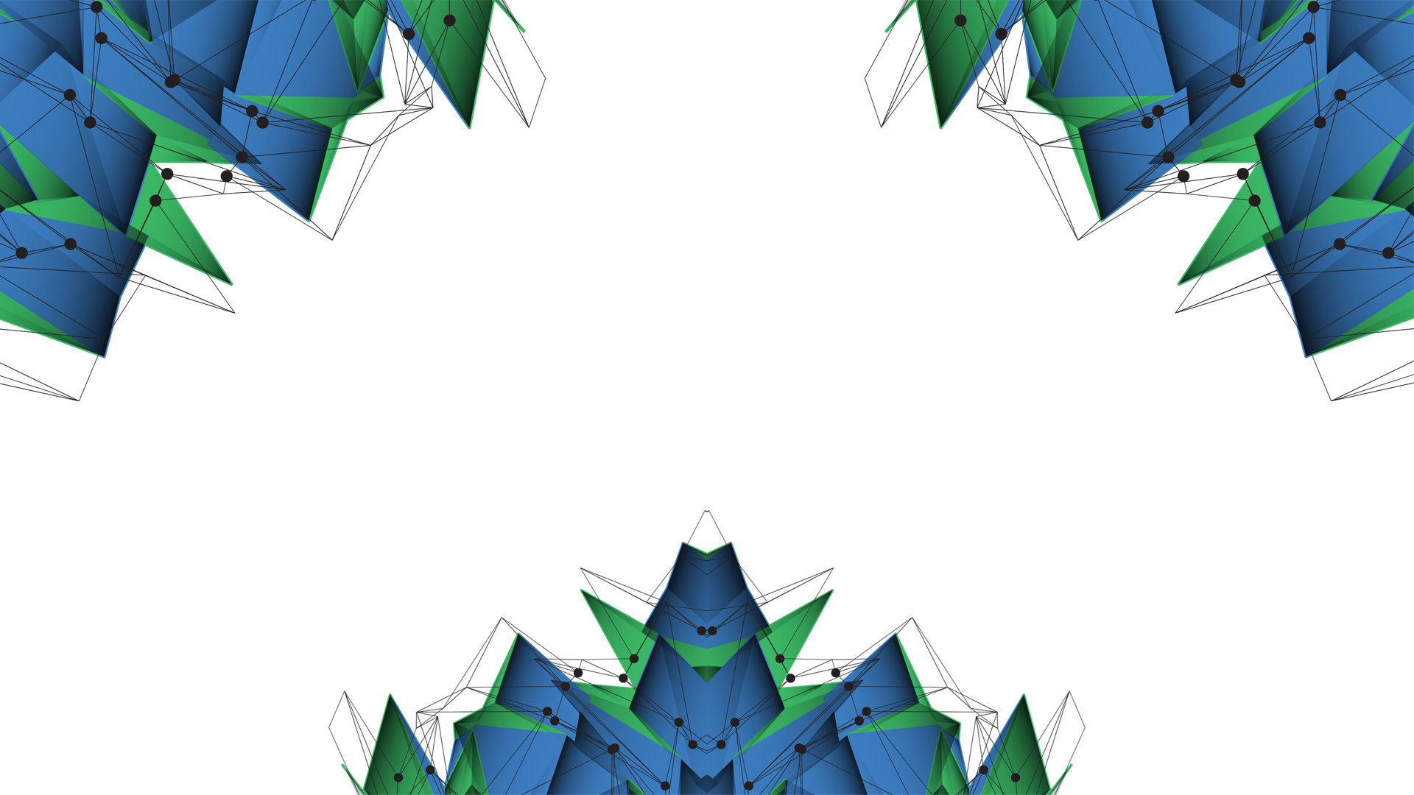
Maximizing Value within the Energy Sector
Proof of concept
Laura Foulquier

Slide 3
Concept
Geomechanics is using parameters to determine if a well is stable or not
Insurance can use the same parameters to rank wells (depending on the well type, drilling events encountered in nearby wells, the formation drilled (rock type, etc …))
Assumption: access to the well-to-be-drilled location

Slide 4
Well Database Format
A well database is built containing already-drilled wells and their:
Name
Location
Their “stability” score
Geospatially indexed (faster queries)
The closest to the well-to-be-drilled, the more weight (inversion distance weighting)
Well Name | Northing | Easting | Projection | Basin | Score

Slide 5
Well Database End of well report information
Available information from End of Well Report
General Information
Well Name
Location (Easting, Northing, Basin)
Drilling summary
Drilling events: losses (minor or major), stuck pipe, pressure kick, blow out, pack off, tight spot, sidetrack
Best practice: Formation integrity test (FIT), reaming , (extended) leak-off test (XLOT)
Notes:
Reaming : cleaning

Slide 6
Well Database Ranking Drilling events
A well stability can be determined by looking at the different events encountered while drilling
To each drilling event is assigned a score, determined by using machine learning mechanisms
For each well a final score is computed depending on the encountered drilling events and their occurrence
The more negative the final score the less stable the well was
 | Drilling events | Score
Delays Instability | Blowout | - 100
 | Pressure kick | - 20
 | Pack Off | -10
 | Stuck pipe | -10
 | Sidetrack | -50
 | Tight spot | -10
Good Practice | Formation integrity test / FIT | 10
 | Reaming | 10
 | Leak Off Test / LOT | 30

Slide 7
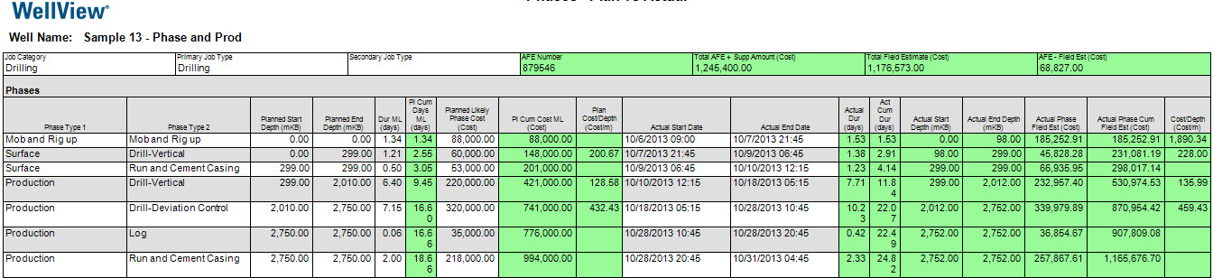
Score Weighting Machine learning
Planned costs
Actual costs
Overtime and/or overbudget wells are common in the oil industry
Machine learning
Count type and occurrence of drilling events versus the delay (days) or overbudget ($)
Estimate the weight of each drilling event as a function of days of delay or overbudget
Notes:
Picture: www.peloton.com

Slide 8
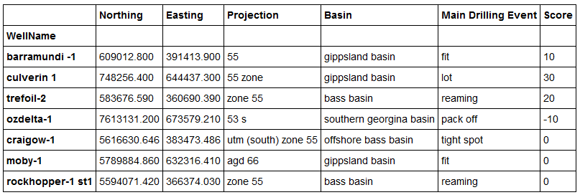
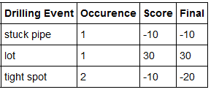
Well Database Examples
A first table is created per well which count the occurrence of each drilling event and compute the final score
The final scores for each drilling event is then summed and saved in the main well database, as well as the drilling event which was encountered most time
Well CRAIGOW-1

Slide 9
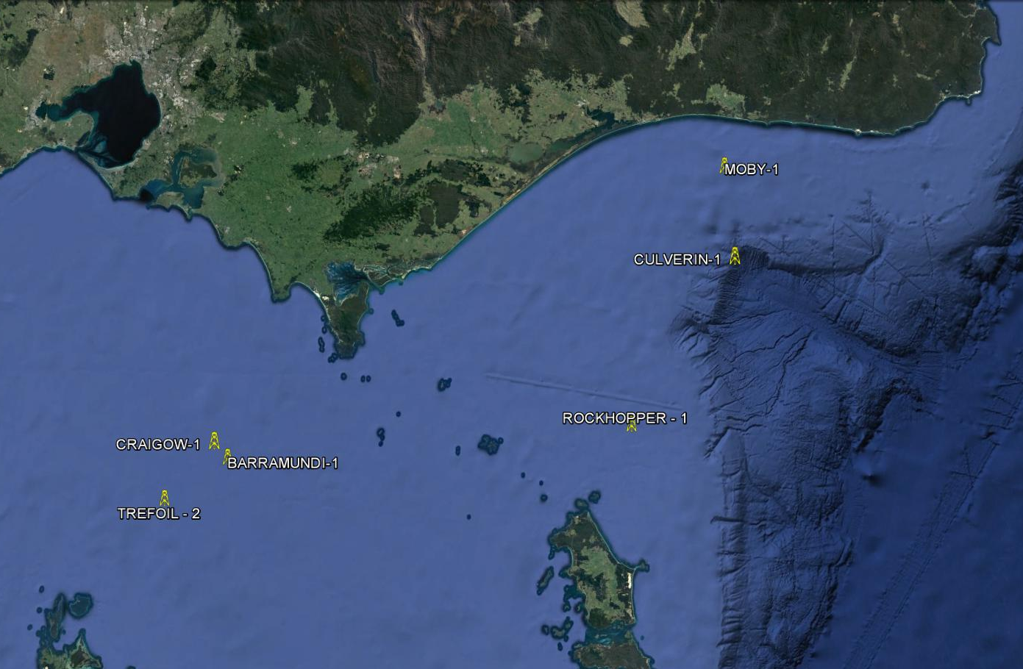
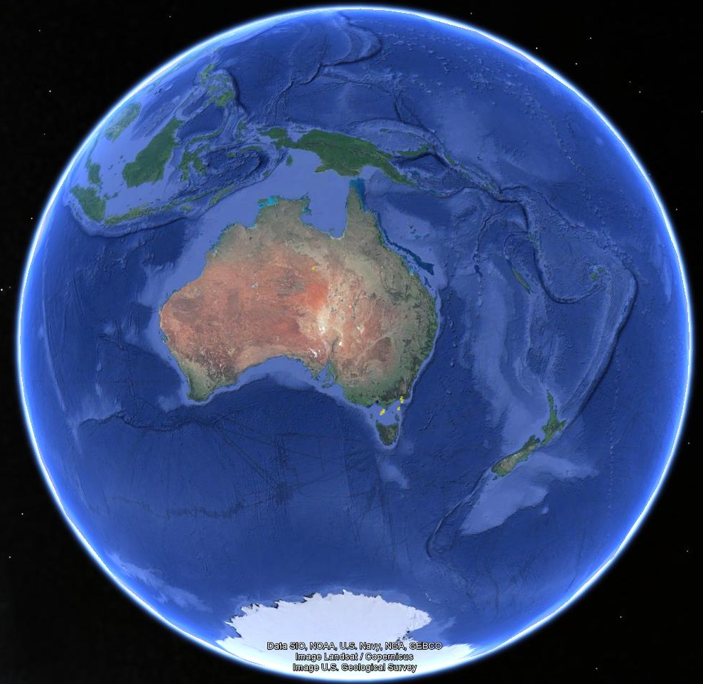
Proof of concept Visualisation

Slide 10
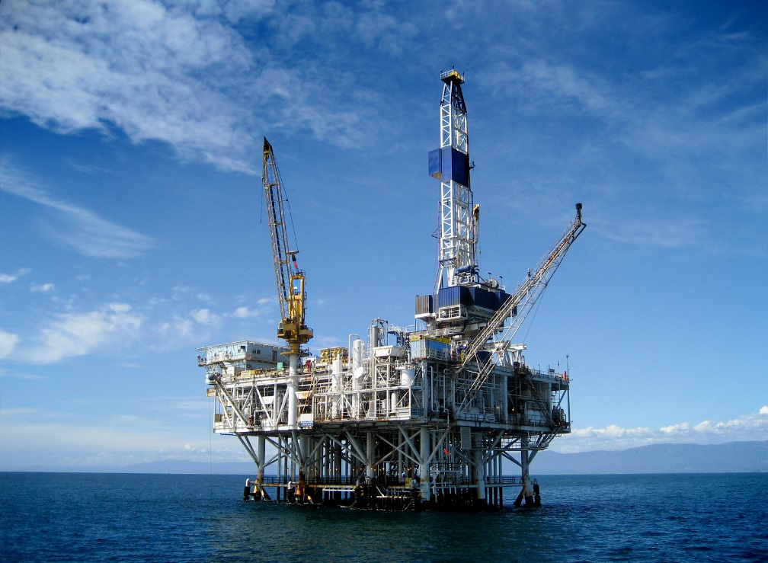

Proof of concept Summary
Well Spec.
Coordinates
Well Database
Find the closest wells in the area
Premiums estimation
Challenging area to drill ?

Slide 11
Next Step Focus on Formation
Some formation are more challenging to drill than others due to rock parameters and mechanics (density, cohesion, etc …)
From the asset specification: get the details of the expected drilled formation (type and meters drilled)
Formation Name | Type | Risk | Meters Drilled | Score
 | Sandstone | 10
 | Limestone | 30
 | Shales | 50
 | Salt | 80

Slide 12
Questions ?

Slide 14
Available Well Databases Around the World
National Data Repository (NDR) : preserve and promote data related to the petroleum exploration and production (E&P) sector
Norway – Diskos NDR
Joint venture consisting of Norwegian Petroleum Directorate (NPD) and oil companies
Kenya – National Data Center
100% government funded
Canada – Data Management Centre
Funded 50/50 by federal and provincial governments (+ funds from industry)
Australia – Geoscience Australia Repository: Wells and Survey
100% government funded
Worldwide – IHS International & Production Database(more than 700,000 wells available)
Owned by IHS
Notes:
https://en.wikipedia.org/wiki/National_Data_Repository
Australia: http://dbforms.ga.gov.au/pls/www/npm.pims_web.search

